Slide 1
Technical communication

Slide 2
Communicating technical information is not like casual chatting or even writing an essay. It requires a structured and specialized approach. This is what we call Technical Communication.

Slide 3
What is Technical Communication?.
Definition:
Technical communication is the process of creating, designing, and sharing information that is clear, concise, and useful for a specific audience.
1. Technical communication is the study of the targeted audience and then finding out the best way to present the information.
2. It involves gathering knowledge from experts and customers by conducting interviews, testing their topics, studying existing information and finally reshaping this information, so that the correct audience can access, understand and use it.

Slide 4
Features of technical communication are :
Technical communication has specialised content i.e., specific subject matter. However, technical communication is not communication about a specific technical topic, but about any technical topic.
In Technical communication the receiver of the information is the audience. Technical communication is the delivéry of technical information to a specific audience in a way which is adopted to the needs, level of understanding and background of the audience.

Slide 5
III. Technical communication has the specific purpose i.e., it is always purposive.
IV. It provides organized information that aids in quick decision-making.
V. It disseminates knowledge in oral or written form.

Slide 6
Nature of Technical Communication
The nature of technical communication refers to its fundamental characteristics, which distinguish it from other forms of communication. These are:
Purpose-Oriented:
  The primary goal of technical communication is to inform, instruct, or persuade the audience to achieve a specific objective.
  For example, a user manual explains how to operate a device, and a project report presents findings to stakeholders.
Audience-Centric:
  The success of technical communication depends on understanding the audience.
  You must consider their level of expertise, needs, and expectations. For instance, a software manual for beginners uses simpler language than one for advanced users.
Clarity and Precision:
  Technical communication avoids ambiguity and uses precise terms to convey information accurately.
  For example, in a machine's operating guide, instructions like "Set the temperature to 150°C" are much clearer than saying "Set the temperature high."

Slide 7
4.Collaborative Nature:
  Often, technical communication involves teamwork. Experts from different fields contribute to creating a comprehensive document or presentation.
  For example, engineers, designers, and marketing professionals may collaborate on a product brochure.
5.Visual and Verbal Balance:
  Effective technical communication often integrates visuals (charts, diagrams, graphs) with text to enhance understanding.
  Example: An infographic explaining data trends in a report.
6.Objective and Ethical:
  It must be factual, unbiased, and truthful. Inaccurate or misleading information can lead to significant problems, including legal issues and safety risks.
  Example: Safety manuals in industries like aviation must present accurate guidelines to prevent accidents.

Slide 8
Scope of Technical Communication
The scope refers to the range of areas and activities where technical communication is applied. It is broad and continues to expand with advancements in technology and globalization.
Written Communication:
  Examples: Reports, proposals, user manuals, memos, emails.
  Purpose: Provides detailed information in a structured format. For instance, project reports document progress and outcomes for stakeholders.
Oral Communication:
  Examples: Presentations, meetings, and interviews.
  Purpose: Helps share ideas, present findings, and facilitate discussions.
  Example: An engineer explaining a design concept to a client during a meeting.

Slide 9
Visual Communication:
  Examples: Diagrams, charts, infographics, and schematics.
  Purpose: Makes complex information easier to understand and more engaging.
  Example: A flowchart showing the steps in a manufacturing process.
Digital Communication:
  Examples: Websites, blogs, e-learning modules, and videos.
  Purpose: Leverages technology to reach wider audiences and enhance interactivity.
  Example: An online tutorial on how to use a software application.
Scientific and Technical Documentation:
  Examples: Research papers, lab reports, technical specifications, and data sheets.
  Purpose: Records and communicates technical knowledge for reference or replication.

Slide 10
Instructional Communication:
  Examples: Training manuals, how-to guides, and troubleshooting documents.
  Purpose: Provides step-by-step instructions for tasks or operations.
  Example: A manual for assembling furniture.
Global and Multicultural Communication:
  Technical communication often involves international audiences. It must account for language differences, cultural norms, and diverse expectations.
  Example: A product manual translated into multiple languages for global markets.

Slide 11
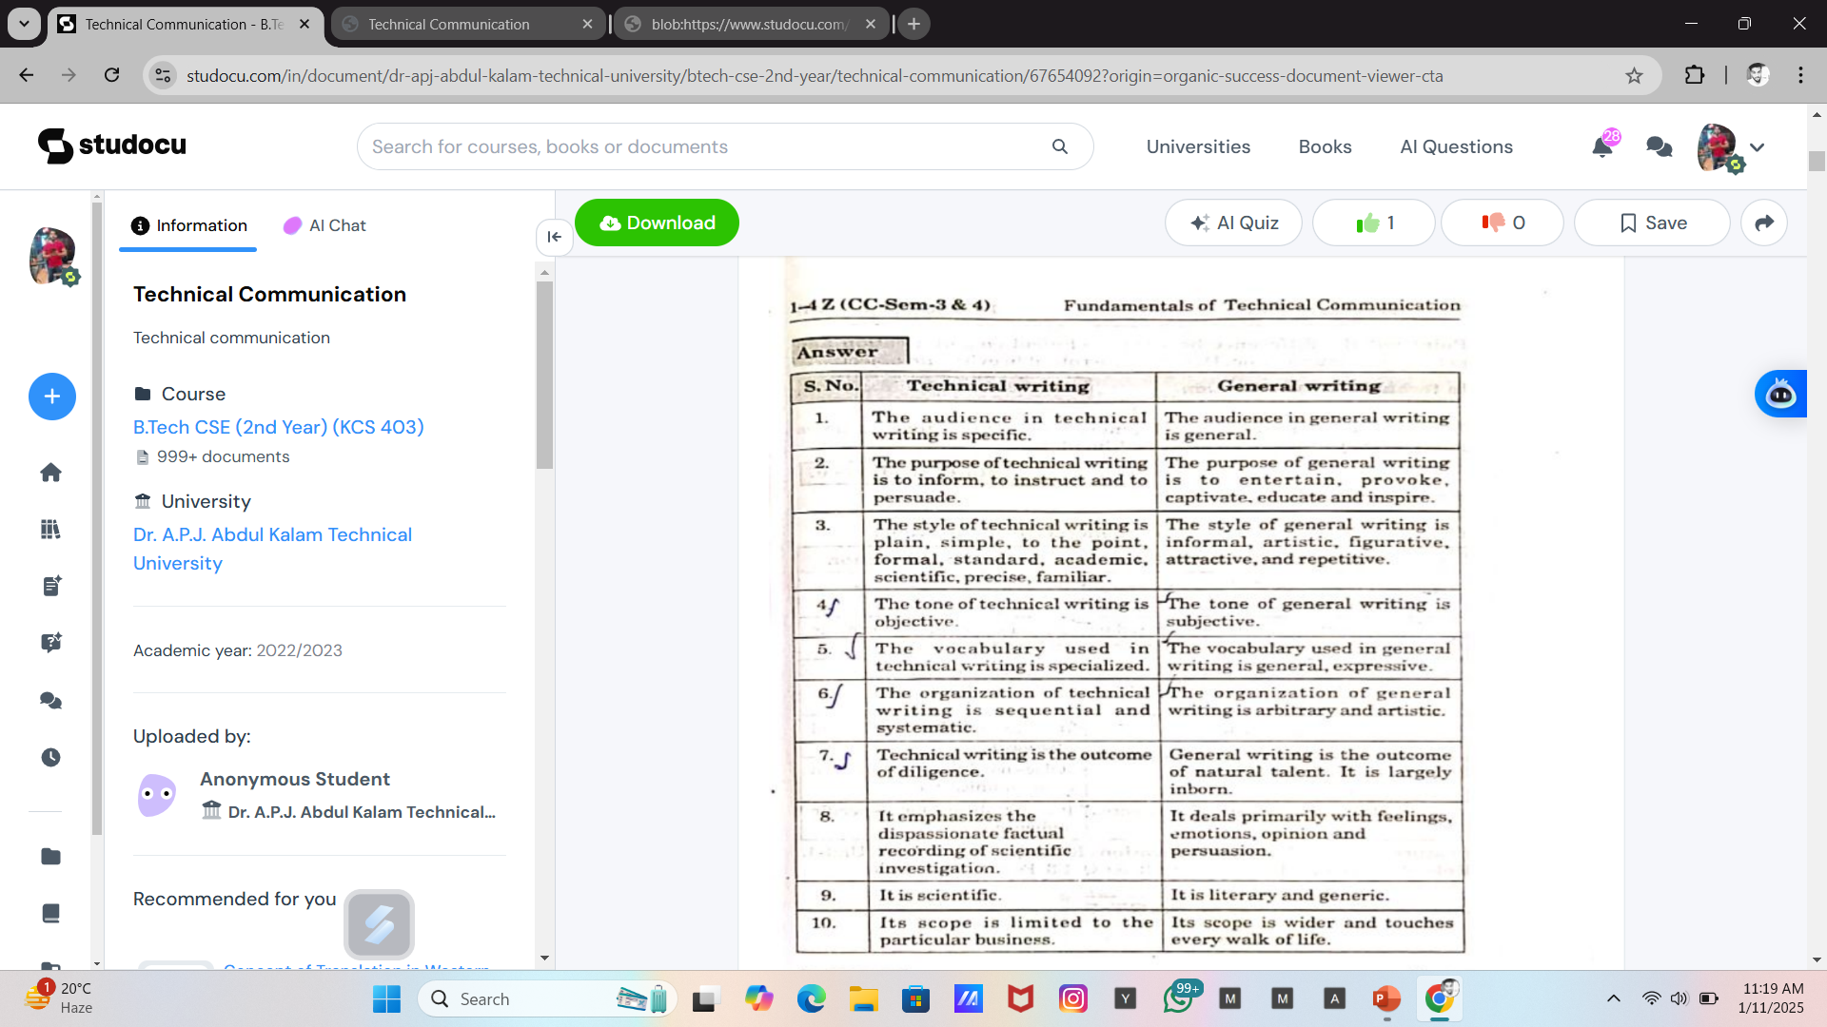

Slide 12
Common Characteristics of Technical Writing
Focused on audience: Technical and workplace documents address a specific audience. The audience may be an individual or a group, and it may or may not be known to the writer. While there is always a primary audience addressed, there may be a secondary audience. Thus, an understanding of the reader or user of a technical document is important.
Rhetorical, persuasive, purposeful, and problem-oriented: Technical communication is all about helping the reader or user of a document solve a problem or compel others to act or do. For example, the syllabus of your calculus class informs the students what is expected of them; the university’s web site provides information to potential students about how to apply or to current students about where to seek assistance. Identification of a specific purpose and a particular audience are the first two steps of technical writing.
.

Slide 13
Professional: Technical communication reflects the values, goals, and culture of the organization and as such, creates and maintains the public image of the organization. Look at your university’s website to see what picture it conveys, or consider the Government. In 2010, the Plain Writing Act was enacted to promote clear government communication that the public can understand and use. The Act calls for writing that is clear, concise, and well-organized.
Design Centered: Technical communication uses elements of document design such as visuals, graphics, typography, color, and spacing to make a document interesting, attractive, usable, and comprehensible. While some documents may be totally in print, many more use images such as charts, photographs, and illustrations to enhance readability and understanding and simplify complex information.

Slide 14
Research and Technology Oriented: Because of workplace demands, technical and workplace writing is often created in collaboration with others through a network of experts and designers and depends on sound research practices to ensure that information provided is correct, accurate, and complete.
Ethical: Lastly, technical communication is ethical. All workplace writers have ethical obligations, many of which are closely linked to legal obligations that include liability laws, copyright laws, contract laws, and trademark laws.

Slide 15
Importance of technical communication
Technical communication plays a vital role in bridging the gap between complex technical concepts and effective understanding by diverse audiences. It ensures the smooth flow of information in various professional, academic, and industrial settings. The following points highlight its significance:
Clarity in Information Sharing
Technical communication simplifies complex ideas and data, making them accessible to a wide range of audiences, including non-technical stakeholders. This clarity ensures proper understanding and reduces misunderstandings.
Enhances Professionalism
Well-structured technical documents such as reports, proposals, manuals, and emails reflect the professionalism and credibility of an individual or organization.
Facilitates Decision-Making
By presenting technical data in a concise and precise manner, technical communication aids managers and stakeholders in making informed decisions.

Slide 16
4. Bridges Communication Gaps
It ensures effective communication between technical experts and non-technical individuals, fostering collaboration in multidisciplinary teams.
5. Supports Product Development and Usage
User manuals, instructional guides, and troubleshooting documents are examples of technical communication that help consumers understand and use products efficiently.
6. Essential for Workplace Success
Engineers, scientists, and professionals need strong technical communication skills to present their ideas, prepare reports, and interact with clients and colleagues effectively.

Slide 17
7. Promotes Safety and Compliance
Accurate technical documentation ensures adherence to safety standards and regulations, minimizing risks in industries like healthcare, construction, and manufacturing.
8. Global Collaboration
In a globalized work environment, technical communication supports collaboration across languages and cultures, ensuring uniform understanding.

